Slide 1
Optimizing Your Computing
Christina Koch ckoch5@wisc.edu
Research Computing Facilitator
University of Wisconsin - Madison

Slide 2
Why Are We Here?

Slide 3

Why Are We Here?
To do SCIENCE!!!
A lot of science is best-done with computing – sometimes, LOTS of computing
Science needs to be reproducible
And, we’d really like science to happen fast(er)

Slide 4
Getting the most out of computing (for research)

Slide 5
Computing Types
At the beginning of the week, we talked about two different approaches for tackling large compute tasks...
high-throughput
high-performance (e.g.MPI)

Slide 6
Two Strategies
High Throughput
High Performance
Focus: Workflows with many small, largely independent compute tasks
Optimize: throughput, or
time from submission to overall completion
Focus: Workflows with large, highly coupled tasks
Optimize: individual tasks, software, communication between processes

Slide 7
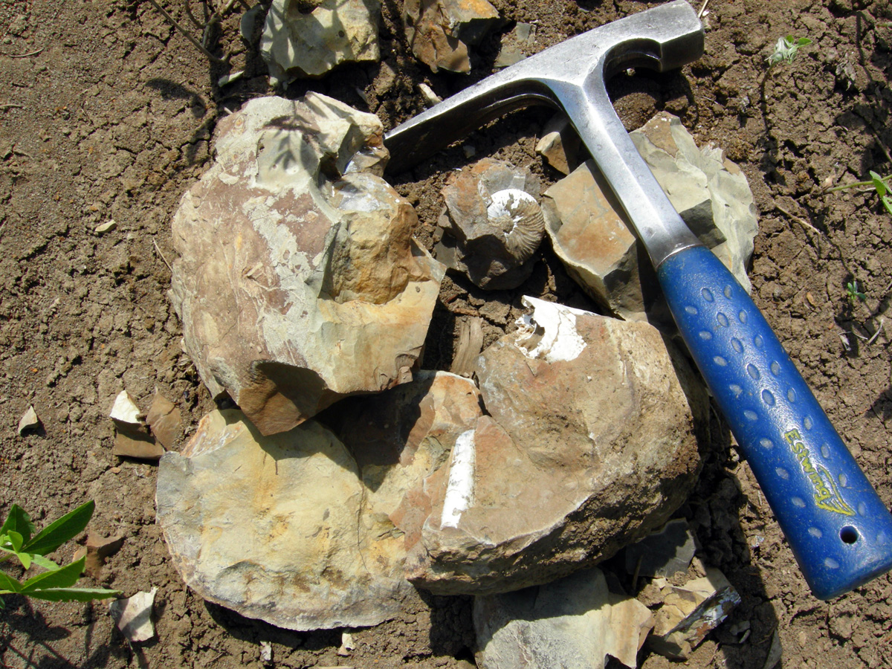
Making Good Choices
How do you choose the best approach?
Is your problem “HTC-able”?

Slide 8
Typical HTC Problems
batches of similar program runs (>10)
“loops” over independent tasks
others you might not think of …
programs/functions that
process files that are already separate
process columns or rows, separately
iterate over a parameter space
a lot of programs/functions that use multiple CPUs on the same server
Ultimately: Can you break it up?

Slide 9
What is Not HTC?
fewer numbers of jobs
jobs individually requiring significant resources
RAM, Data/Disk, # CPUs, time
(though, “significant” depends on the HTC compute system you use)
restrictive software licensing

Slide 10

The Real World
However, it’s not just about finding the right computing approach to your problem.
These approaches will be *most* effective if they’re running on appropriate compute systems.

Slide 11
The Real World
Not all compute systems are created equal.
Two questions to ask:
What resources are available to me?
Which one is the best match for the kind of computing I want to do?

Slide 12
Two examples: Local HTC and OSG

Slide 13
CHTC Recommendations
 | Ideal Jobs | Still very advantageous | Less-so, but maybe
Cpus (Gpus) | 1 (1) | <20 (1) | >20 cpus, using multiple nodes
Walltime | <12 hours* or checkpointable | <24 hours* or checkpointable | up to 2 weeks
RAM | 1-2GB | up to TBs | >4TB
Input | <100MB | up to TBs | N/A
Output | <4GB | up to TBs | N/A
Software | ‘portable’ | anything else that’s not → | licensed, non-Linux

Slide 14
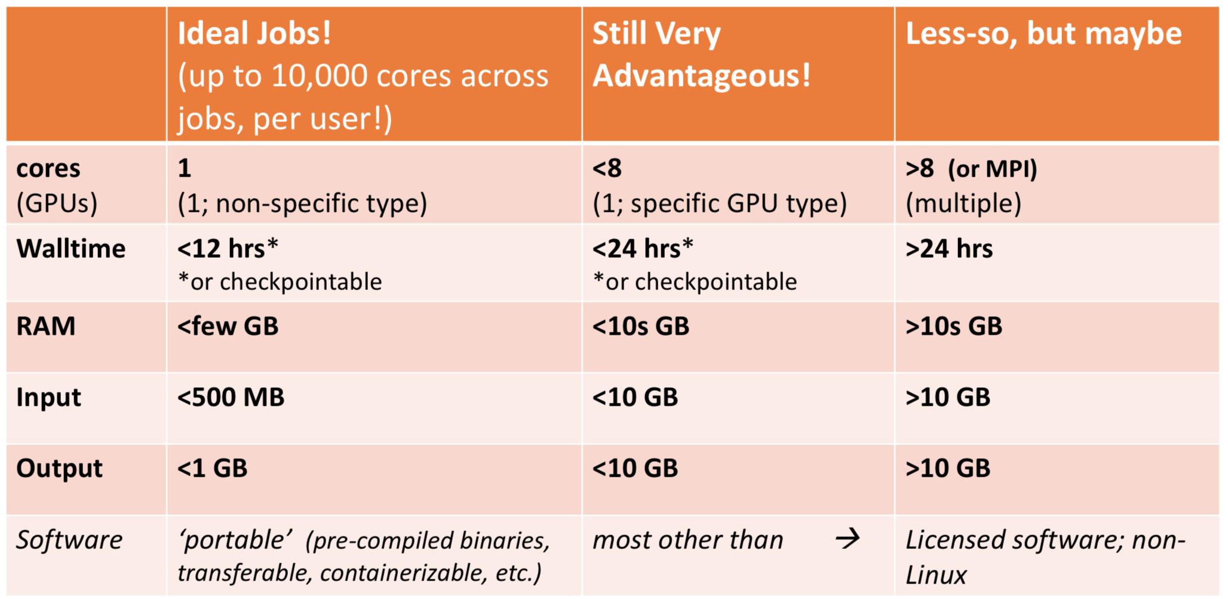
OSG Recommendations

Slide 15
What about your local compute center?

Slide 16
Campus Resources
Check out your local campus compute system
Some considerations:
Who has access? Are there allocations?
What kind of system? What is it optimized for?
An HPC cluster may not handle lots of jobs well, in the same way that an HTC system has limited multicore capabilities - be aware of how a system matches/doesn’t match your computation strategy.
Ask questions! Be a good citizen!
If local resources are limited, explore other options.

Slide 17



Beyond Your Campus
Open Science Grid!
This afternoon, Tim will talk about ways to access OSG after the school is over
Other grids
European Grid Infrastructure
Other national and regional grids
Commercial cloud systems

Slide 18
The Payoff
HTC is, beyond everything, scalable
If you can run 10 jobs, you can run 10,000, maybe even 10 million
Worth pursuing the right kind of resources (if you can) for the right kind of problem.
n processors
time

Slide 19
Getting the Most out of HTC

Slide 20
run as many jobs as possible on as many computers as possible
The HTC Goal:

Slide 21
Key HTC Tactics
Increase Overall Throughput
Optimize for total work, not individual jobs
Utilize Resources Efficiently!
Bring Dependencies With You
Scale Gradually, Testing Generously
Automate As Many Steps As Possible

Slide 22
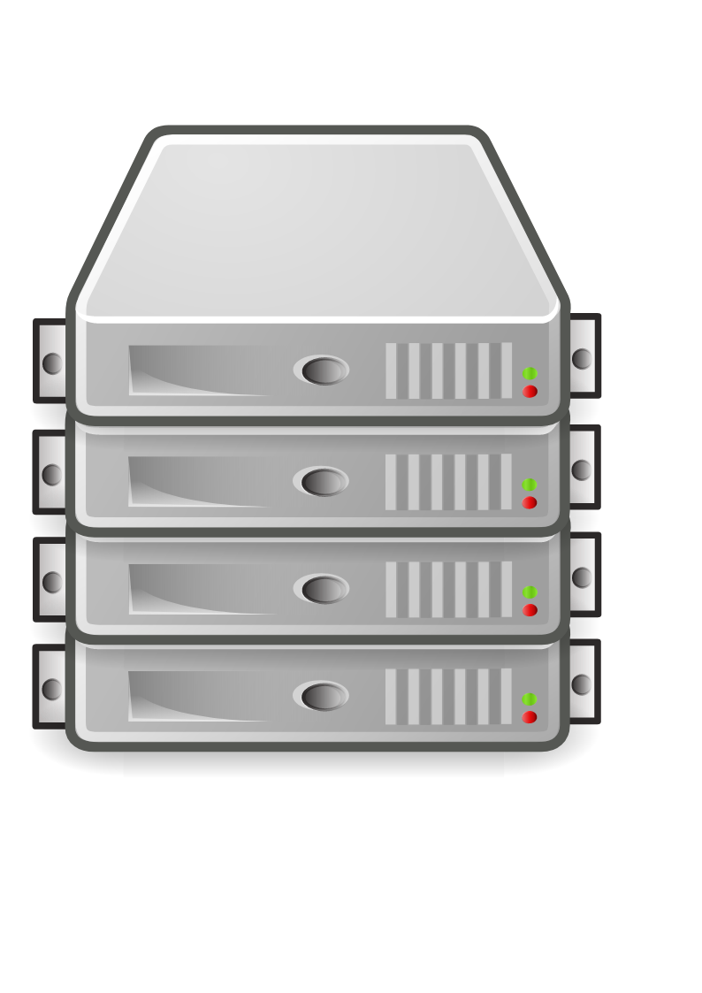
Throughput, revisited
In HTC, we optimize throughput: time from submission to overall completion
Instead of making individual jobs as fast as possible, optimize how long it takes for all jobs to finish.
We do this by breaking large processes into smaller pieces (to have more simultaneous processing power)

Slide 23
Breaking Up
Break work into parallel (separate) jobs
reduced job requirements = more matches
not always easy or possible
Strategies
break HTC-able steps out of a single program
break up loops
break up input
Use self-checkpointing if jobs are too long
Consider grouping tasks if jobs are short!

Slide 24
Self-Checkpointing
Solution for long jobs and “shish-kebabs”
Changes to your code
Periodically save information about progress to a new file (every hour?)
At the beginning of script:
If progress file exists, read it and start from where the program (or script) left off
Otherwise, start from the beginning
Change to submit file:
when_to_transfer_output = ON_EXIT_OR_EVICT

Slide 25
Solutions for Larger Files
File manipulations
split input files to send minimal data with each job
filter input and output files to transfer only essential data
use compression/decompression
Follow file delivery methods from yesterday for files that are still “large”

Slide 26
Key HTC Tactics
Increase Overall Throughput
Utilize Resources Efficiently!
Jobs will match to more resources
Bring Dependencies With You
Scale Gradually, Testing Generously
Automate As Many Steps As Possible

Slide 27

Know and Optimize Job Use of Resources
CPUs (“1” is best for matching; essential for OSG)
restrict, if necessary/possible
software that uses all available CPUs is BAD!
CPU Time
> ~5 min, < ~1 day; Ideal: 1-10 hours
RAM (not always easily modified)
Disk per-job (execute) and in-total (submit)
Network Bandwidth
minimize transfer: filter/trim/delete, compress

Slide 28
Use the Job Log
001 (2576205.000.000) 06/07 11:57:57 Job executing on host: <128.104.101.248:9618>
005 (2576205.000.000) 06/07 14:12:55 Job terminated.
(1) Normal termination (return value 0)
Usr 0 00:00:00, Sys 0 00:00:00 - Run Remote Usage
Usr 0 00:00:00, Sys 0 00:00:00 - Run Local Usage
Usr 0 00:00:00, Sys 0 00:00:00 - Total Remote Usage
Usr 0 00:00:00, Sys 0 00:00:00 - Total Local Usage
5 - Run Bytes Sent By Job
104857640 - Run Bytes Received By Job
5 - Total Bytes Sent By Job
104857640 - Total Bytes Received By Job
Partitionable Resources : Usage Request Allocated
Cpus : 1 1
Disk (KB) : 122358 125000 13869733
Memory (MB) : 30 100 100

Slide 29
Key HTC Tactics
Increase Overall Throughput
Utilize Resources Efficiently!
Bring Dependencies With You
Jobs can run anywhere*
Scale Gradually, Testing Generously
Automate As Many Steps As Possible
*almost

Slide 30
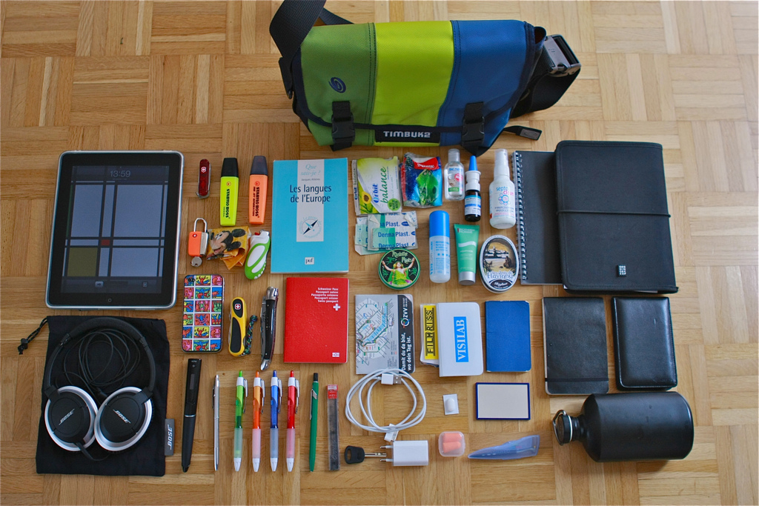
Bring What with You?
Software (covered Wednesday)
Data and other input files
Parameters and random numbers: generate and record ahead of time (for reproducibility)
What else?

Slide 31
Wrapper Scripts Recap
Before task execution
transfer/prepare files and directories
setup/configure software environment and other dependencies
Task execution
prepare complex commands and arguments
batch together many ‘small’ tasks
After task execution
filter/combine/compress files and directories
check for and report on errors

Slide 32
Key HTC Tactics
Increase Overall Throughput
Utilize Resources Efficiently!
Bring Dependencies With You
Scale Gradually, Testing Generously
Saves you time in the long run!
Automate Multiple Steps

Slide 33
Testing, Testing, Testing!
Will be a major focus of our exercises today.
Allows you to optimize resource use (see HTC tactic #2), job length (tactic #1)
Just because it worked for 10 jobs, doesn’t mean it will work perfectly for 10,000 jobs (scaling issues)
Data transfer (in and out)
Discover site-specific problems

Slide 34
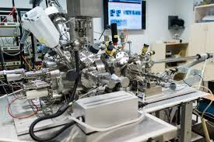
Why test? Imagine if:
You are using a new scientific instrument. Would you run 100 samples without ever running a test (or a few tests)?
Your job accidentally creates a 3GB core dump file because the code is corrupted. What happens if you submit 1,000 jobs with this issue?

Slide 35
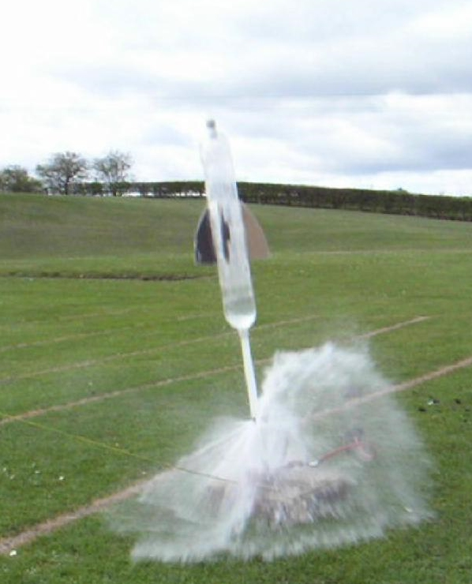
Testing, Testing, One...
Get one job working
Work out software issues, data transfer patterns, etc.
Make subsequent memory/disk requests based on results from this job
How long does the job run?

Slide 36
...Two...
Run a medium/small scale test(s) (10-100 jobs)
Check memory/disk requests when complete. Are they accurate? If not, change them.
Do some percentage of jobs fail? If so, can you figure out why? How will you find/handle failures at a larger scale?
Would it make sense to submit more, smaller jobs or fewer, longer jobs?
How much data is being generated? Do you have space on the submit server to store the results of the full-scale run?

Slide 37
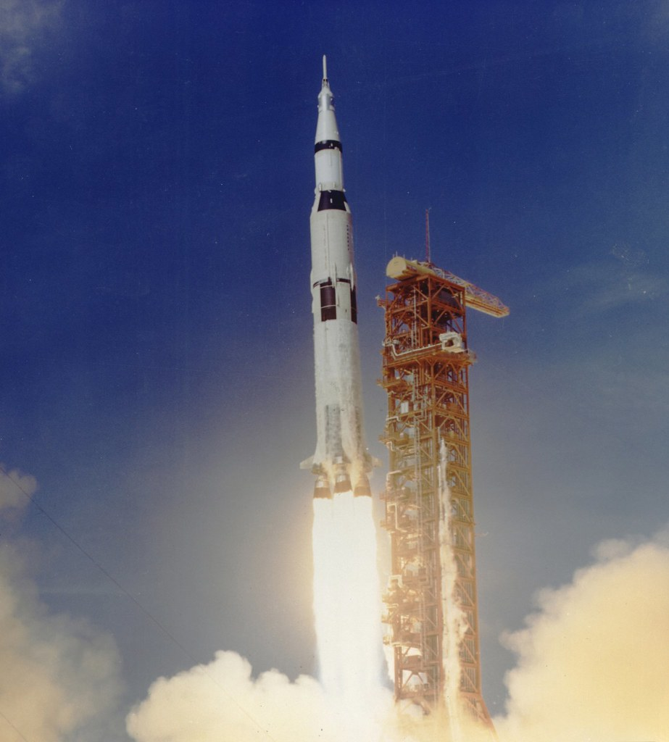
...Three!
If you make significant changes in any of the previous testing steps (or make any other changes to your workflow - new code, new data, new version of your software) -- do another quick test.
Once you’ve done a small and medium test, scale up to the full submission.

Slide 38
Introducing the exercises
Our exercise today will involve developing a workflow (series of sequential pieces)
What you need to know for the first two exercises:
Identify the component pieces (job submissions) of the workflow and the shape of the overall workflow.
Test/optimize the pieces, as described in the previous few slides

Slide 39
Exercise 1.1
Task 1
(days)
Task 2
(minutes)
Notes:
REMAKE!!!

Slide 40
Exercise 1.1
. . .
process ‘0’
process ‘?’
Task 2
Notes:
REMAKE!!!

Slide 41
Exercise 1.2
. . .
? RAM
? MB Disk
? min
(each)
process ‘0’
(filter output)
process ‘?’
(filter output)
(POST?)
(POST?)
(PRE?)
Task 2
(POST?)
? RAM
? GB Disk
? min
Notes:
REMAKE!!!

Slide 42
Questions?
Now: “Joe’s Workflow”
Exercise 1.1 -- Understand and plan (no jobs)
Exercise 1.2 -- Testing jobs
Work in groups of 2-3
Read carefully!
Later:
Lecture: Optimizing Workflows
Exercises 2.1, 2.2

